Slide 1


Wait, really, Microsoft loves Java? - How Microsoft Helps Java Developers to Shift Left

Slide 2

Kevin Harris
Global Black Belt Team
App Innovation Specialist
Kevin.Harris@Microsoft.com
@KevBHar

Slide 3
Goals
How to shift left & accelerate microservices development
Understand Java App Migration & Modernization options in Azure
Dispel myth about Microsoft and Java

Slide 4
Agenda
Shift Left & Accelerate Microservices Development
Demo
Overview of Java Choices on Azure
Dispel Myth about Microsoft & Java
Wrap-up & Resources

Slide 5
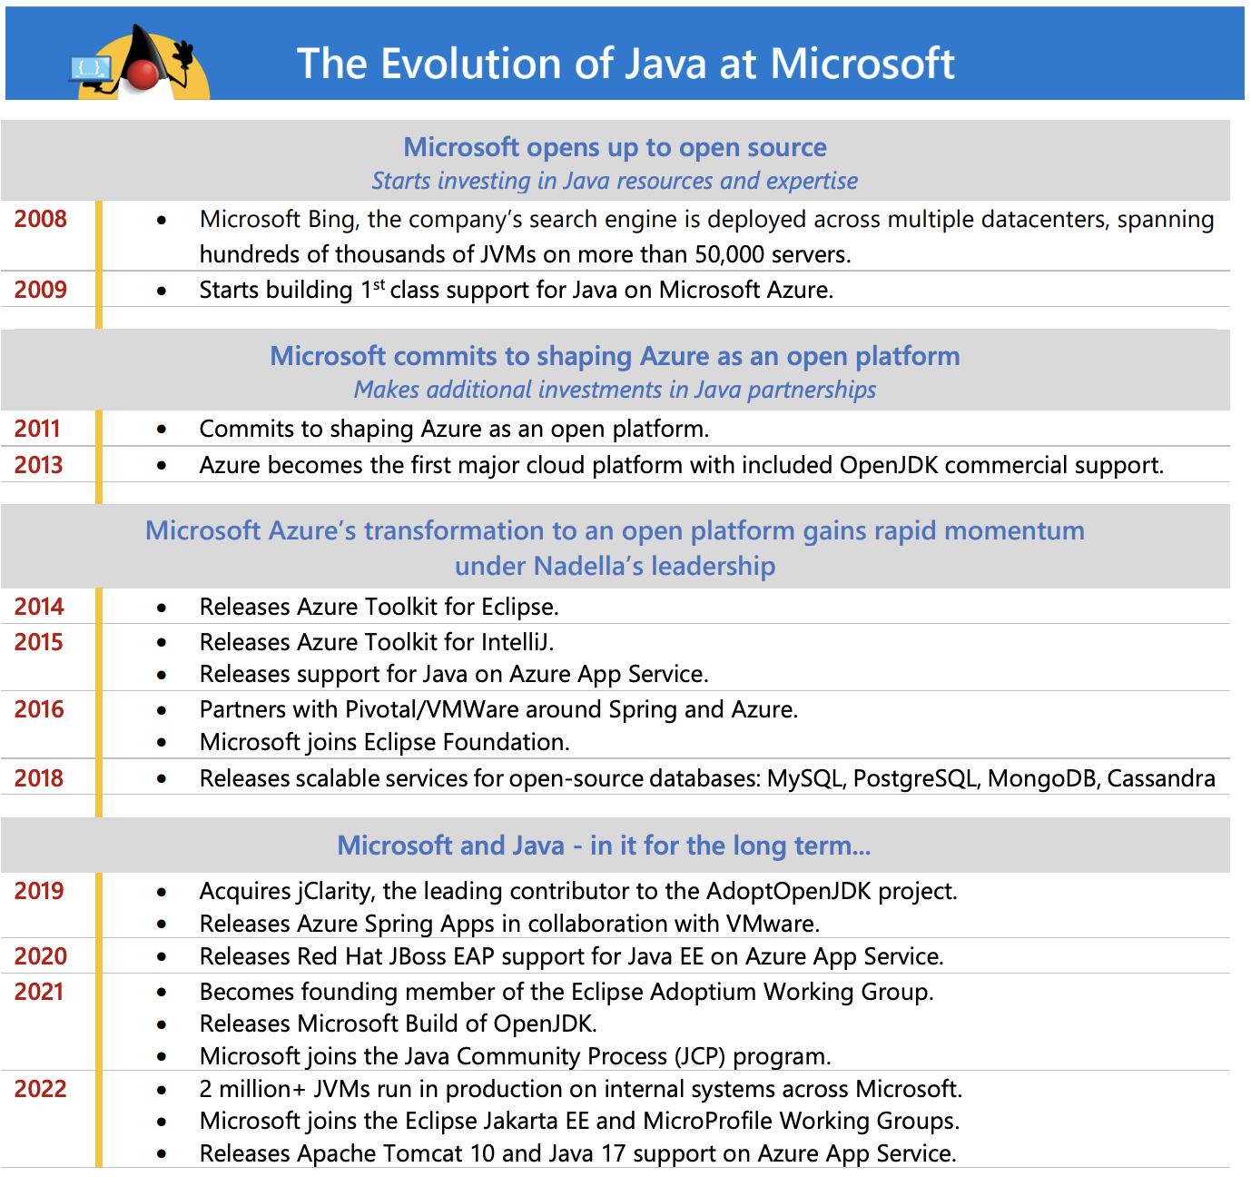
Evolution of Java at Microsoft

Slide 6
Developer environments are where developers do their work
But local dev environments have problems...

Slide 7
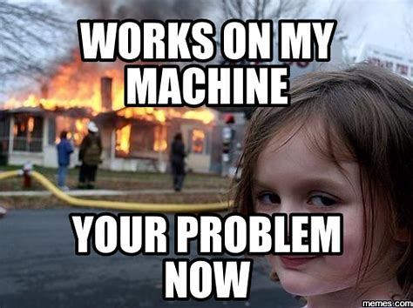

Slide 8

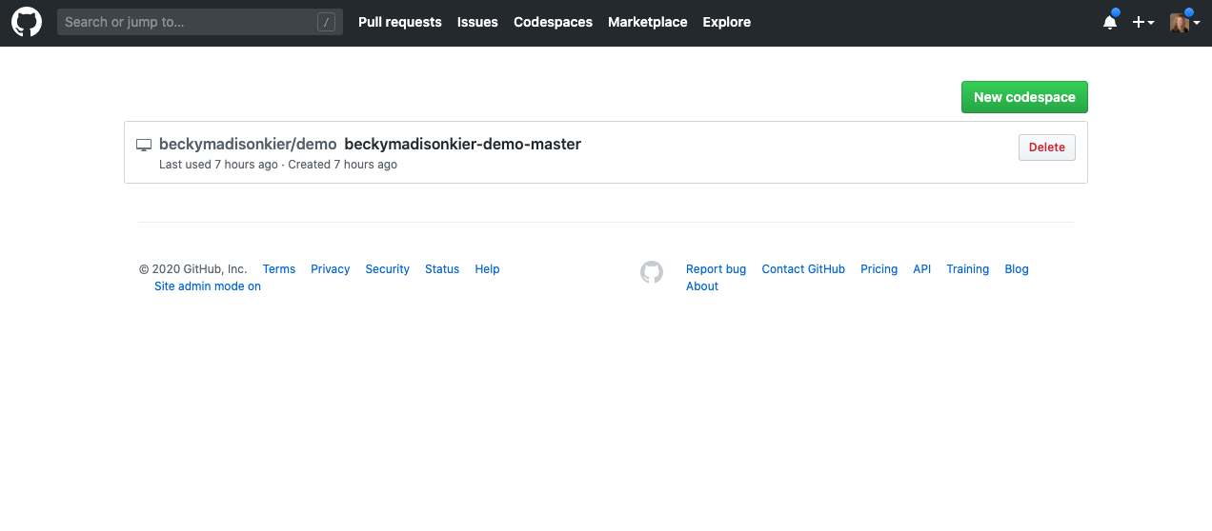
Codespaces
Your instant Linux dev environment
Code without compromise
Code, build, test, debug, and deploy with a complete development environment in your browser.
Simplify your workflow
Automatically set up dependencies and SSH keys. Go from code to commit faster on any project.
Extend and customize
Configure your editor with dotfiles and VS Code extensions to create a consistent environment in every codespace.
https://github.com/Features/Codespaces

Slide 9
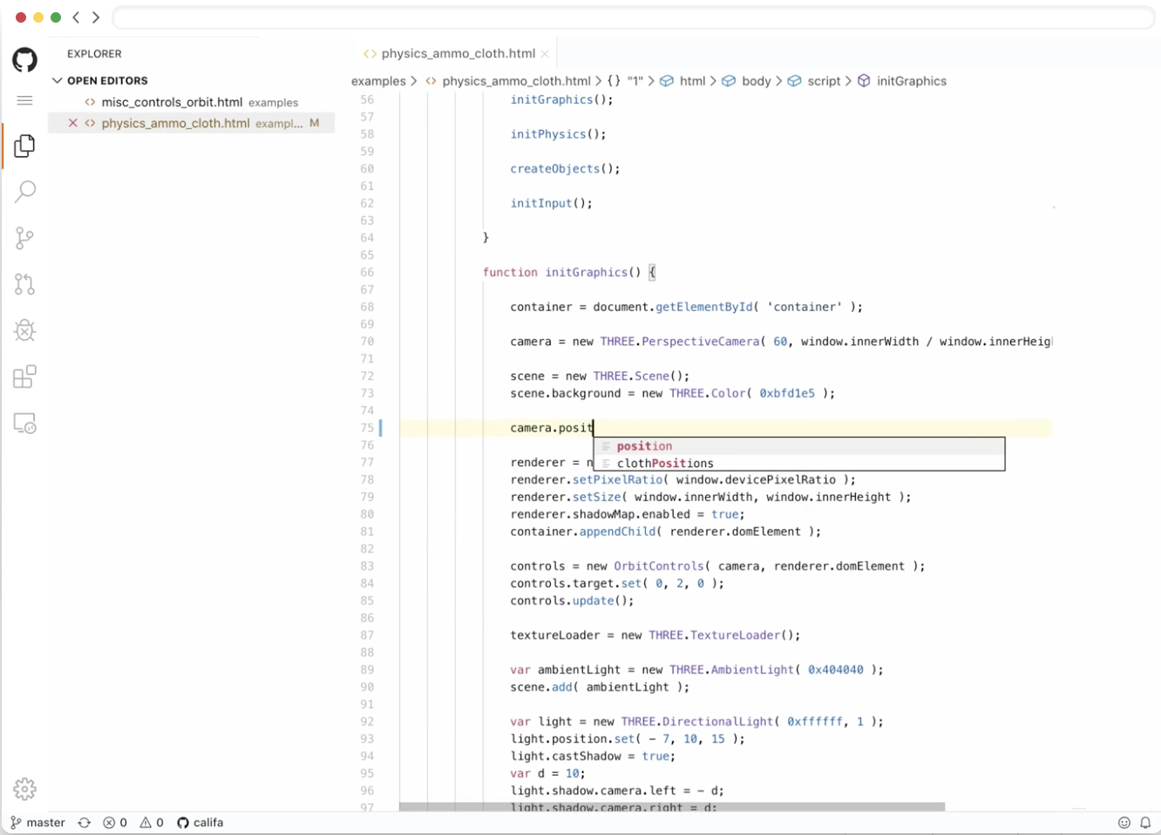
What is Codespaces?
Editor Browser, VS Code, Visual Studio
Azure Containers run services in the cloud
Container
Container
Container

Slide 10
Start contributing in seconds, not hours
Configure with dependencies pre-installed, so developers don’t have to worry about environment setup to start on a new project or pick up an existing one
Spin up unlimited copies of any codespace, so that hackathons and internal learning sessions don’t involve setup time
Security and ops can interact with a project immediately and understand the effects of changes
Accelerate innersource by keeping a fully-functioning environment available together with code

Slide 11
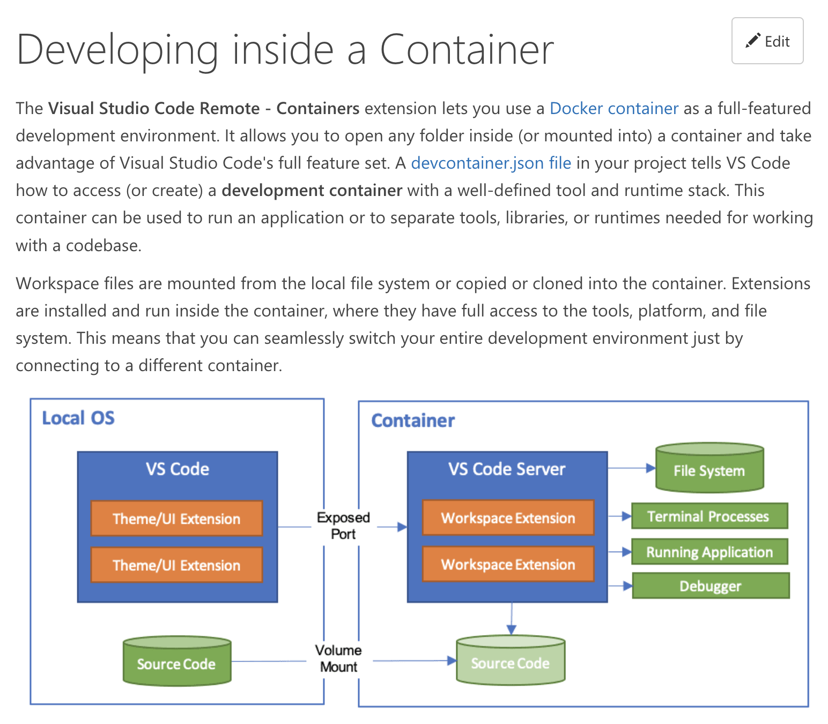
VS Code Remote Containers – Dev Environment in a Container
Notes:
Full JFR recording and visualization.

Slide 12
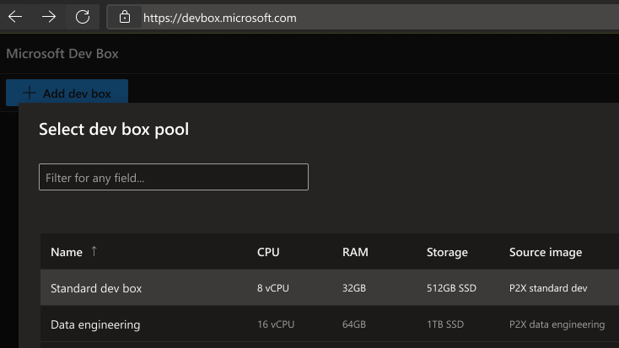
Azure Dev-Box
Your instant Windows dev environment
Transform the developer workstation
Preconfigured project- and task-based dev boxes can be deployed on demand by developers based on their needs.
Streamline dev team collaboration
Windows-based dev boxes support all the tools and resources needed for desktop, mobile, web apps, and game development.
Manage and secure dev workstations
Comprehensive access controls and a centralized view of all dev boxes across the organization help maximize security.

Slide 13

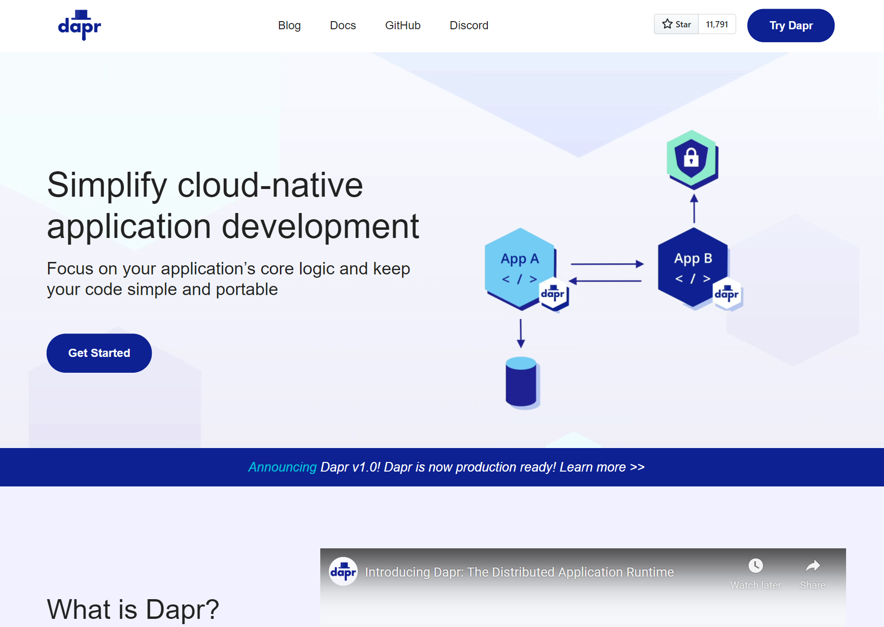
Distributed Application Runtime
Portable, event-driven, runtime for building distributed applications across cloud and edge
dapr.io

Slide 14
Dapr Goals
Best-practices building blocks
Any language or framework
Consistent, portable, open APIs
Adopt standards
Extensible and pluggable components
Platform agnostic cloud + edge
Community driven, vendor neutral

Slide 15

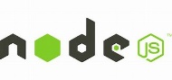





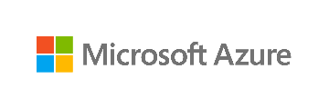






Any cloud or edge infrastructure
Application code
Microservices written in
Any code or framework…
HTTP API
gRPC API
Service-to-service invocation
State management
Publish and subscribe
Resource bindings and triggers
Actors
Observability
Secrets
Extensible
Hosting infrastructure
Azure Arc
On-Premises

Slide 16
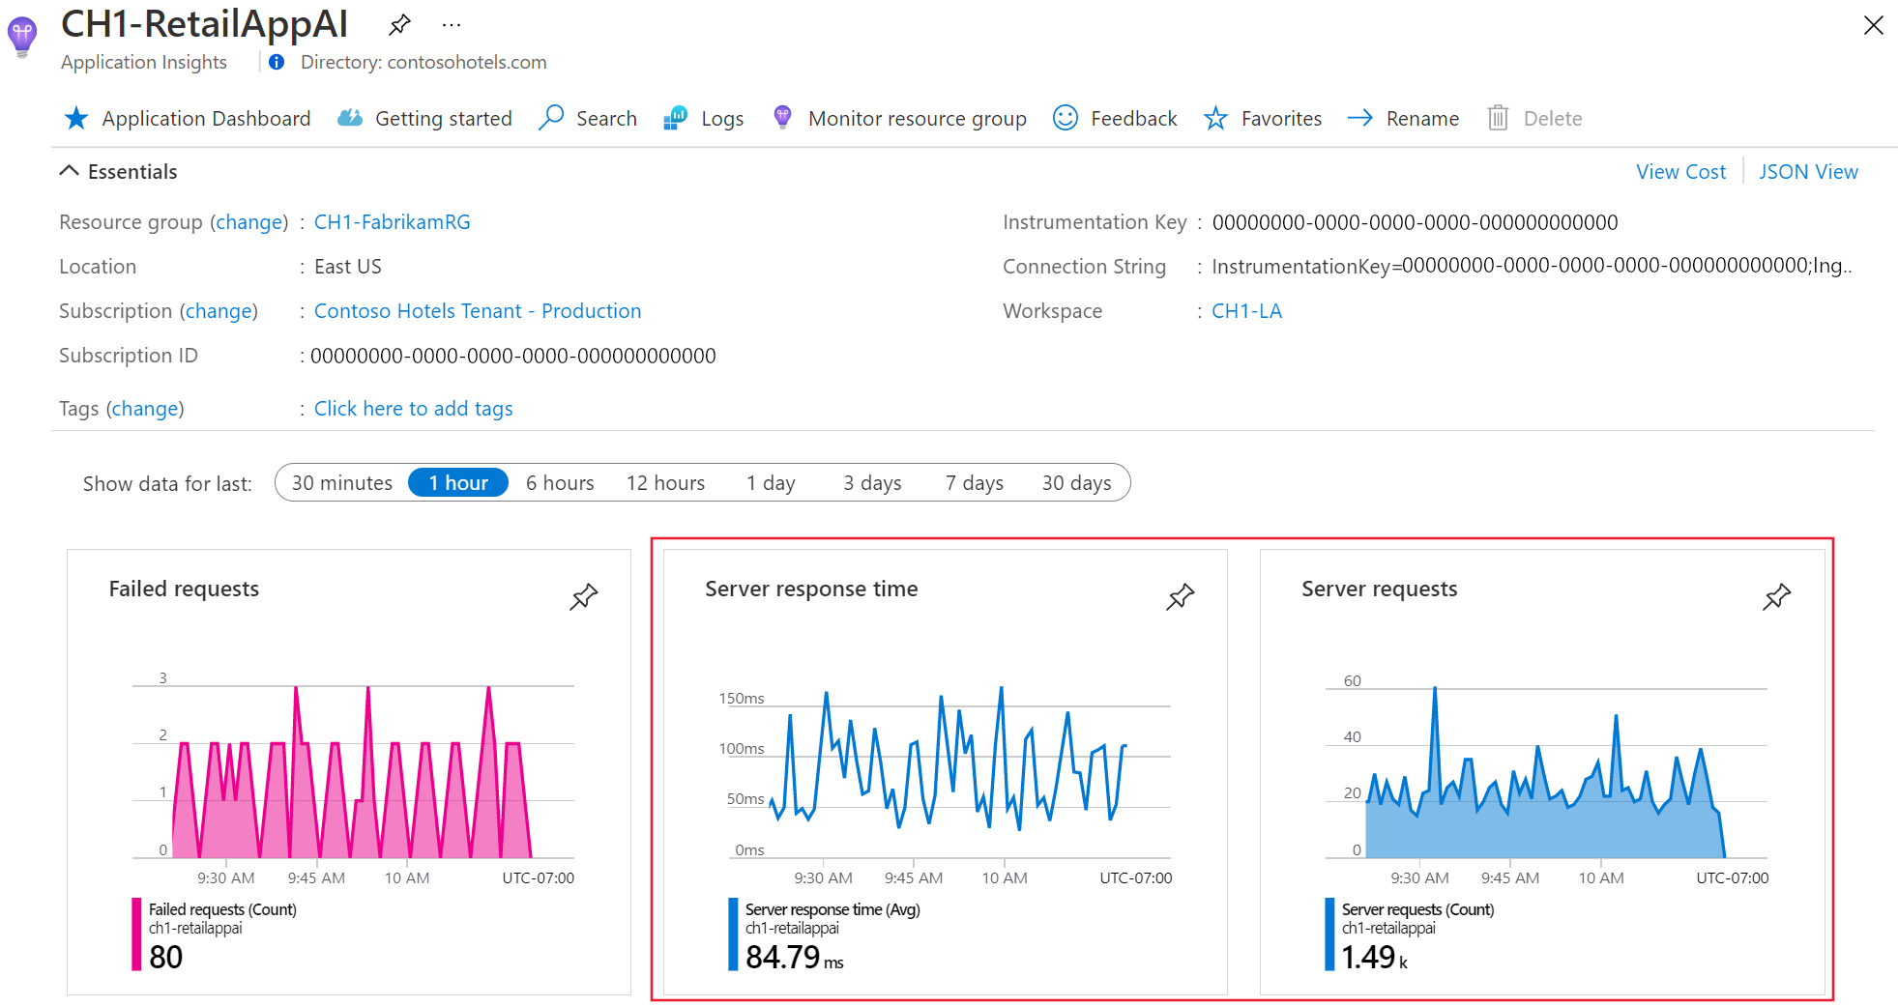
Azure Monitor OpenTelemetry-based auto-instrumentation for Java applications

Slide 17
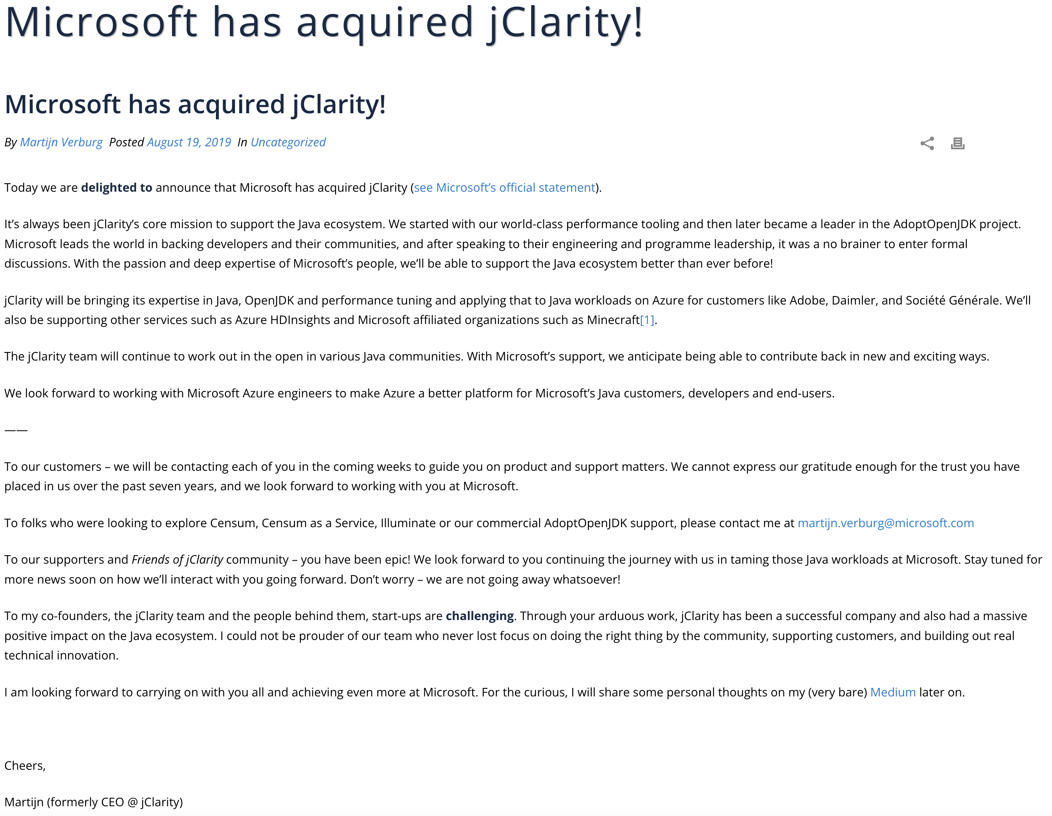
Futures - Java Profiling with Illuminate from jClarity
Notes:
Full JFR recording and visualization.

Slide 18
Demo
https://github.com/kevingbb/jdd2022
UI
SPA in VueJS
API
Spring Boot
DB
Postgre
SQL

Slide 19
Ship faster and reduce costs with fully managed services

Slide 20


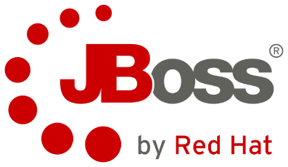
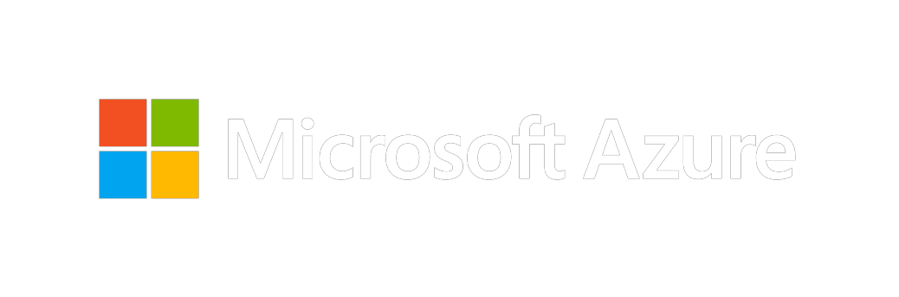
Fully managed PaaS for Tomcat and JBoss EAP Focus on the apps that run your business, not managing infrastructure
App Service
Deploy JAR, WAR or EAR using tools of your choice
Built-in CI/CD with zero downtime deployments
Intelligent troubleshooting and performance optimization
Automatic updates and security patches

Slide 21
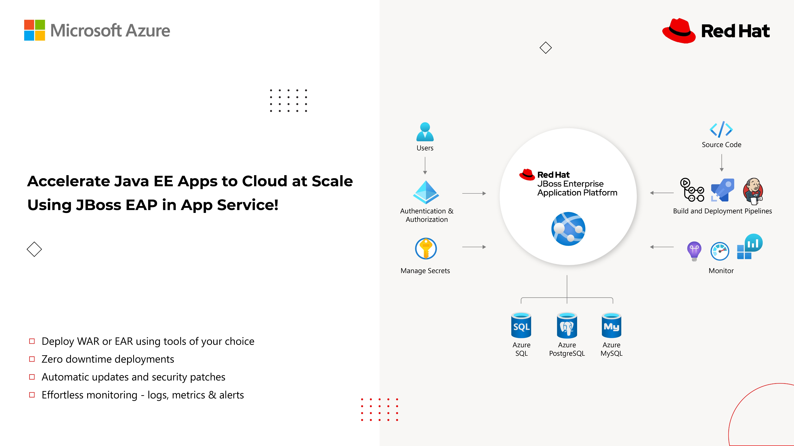

Slide 22
Spring is the most popular Java framework Significant YoY growth and developer adoption
52%
of developers use Spring Boot as their only or primary development platform
Source: State of Spring 2020 Report - https://tanzu.vmware.com/content/ebooks/state-of-spring-2020

Slide 23

Azure Spring Apps Fully managed service for Spring Boot apps
Full integration into Azure’s ecosystem and services
Fully managed infrastructure
Built-in app lifecycle management
Ease of
monitoring
Enterprise ready
Jointly built, operated and supported by Microsoft and VMware

Slide 24






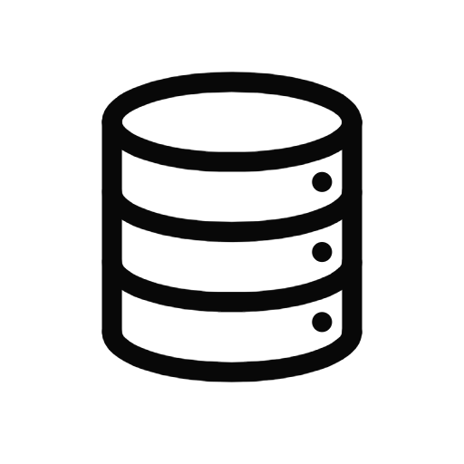

Spring integration with Azure Spring developers can leverage 30+ starters to connect to Azure services with a few lines of configuration and minimal code changes
Spring Cloud
Spring Data
Spring Security
Spring Cache
App Configuration
Event Hubs
Service Bus
Storage
Redis
Functions
SQL Database
MySQL
PostgreSQL
Maria DB
Cosmos DB
SQL
MongoDB
Cassandra
Gremlin
Active Directory (AAD)
AAD B2C
Redis Cache
Spring Messaging
Service Bus
R2DBC
SQL Database
PostgreSQL
MySQL
Spring Resource
Micrometer
Storage
Monitor

Slide 25








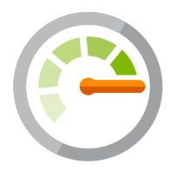







Modernize your Java applications using containers Choose from a variety of tools, orchestrators, and platform services
Development Tools
Container PaaS
Platform
IDEs
Active Directory
Azure Policy
Security Center
Key Vault
Docker
Build Tools
Azure Monitor
Cognitive Services
Service Bus
Azure Advisor
Azure Kubernetes Service
Azure Red Hat OpenShift
GitHub
Azure Arc Management across environments
Azure Container Registry
Azure Container Apps

Slide 26
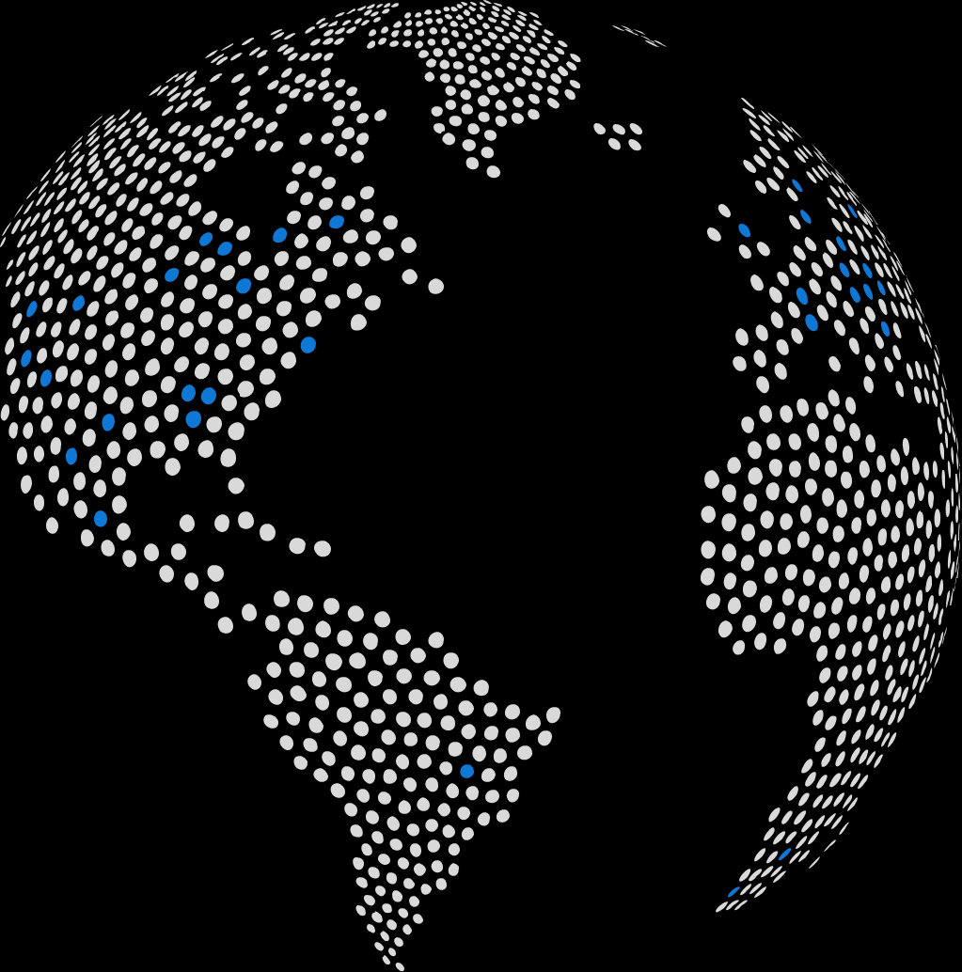
Azure Kubernetes Service (AKS) Enterprise-grade by design
Best practices from
of enterprise engagements
Built-in
Best practices
1000s
3,500
Run Java in more regions than any other cloud provider
Security experts focused on your data security and privacy
Multi-layer Security
24x7x365
Enterprise support
on-call support backed by Kubernetes certified experts

Slide 27

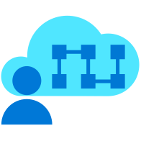
Azure Red Hat OpenShift (ARO) Jointly engineered and operated by Microsoft and Red Hat with an integrated support experience
Enterprise-grade operations, security and compliance
Deploy your business-critical apps with confidence with an industry-leading SLA of 99.95% availability, with PCI DSS, ISO 27001, HITRUST, SOC 2 Type II, and FedRAMP certifications.
Build, deploy and scale Java apps with confidence
Empowering developers to innovate
Promote developer productivity with built-in CI/CD pipelines, then easily connect your applications to hundreds of Azure services such as MySQL, PostgreSQL, Redis, Cosmos DB, and more.
In just minutes, deploy enterprise-grade Red Hat OpenShift clusters on Azure
Scale on your terms
Start a highly available cluster in a few minutes, then scale as your application demand changes; plus, get your choice of standard, high-memory, or high-CPU application nodes. Pay through your Azure subscription.

Slide 28
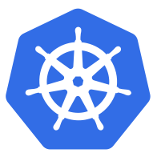



Azure Container Apps
Serverless containers for microservices
Build modern apps on open source
Focus on apps, not infrastructure
Seamlessly port to Kubernetes
Kubernetes
KEDA
DAPR
Envoy

Slide 29








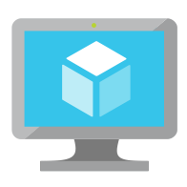









Modernize Java applications on Azure
Frameworks
Java EE/Jakarta EE application servers
Java application frameworks
Microsoft Azure
Infrastructure-as-a-service
Container platform-as-a-service
Platform-as-a-service
Tooling
Azure Kubernetes Service
Red Hat OpenShift
Azure App Service
Azure Spring Apps
IDEs
Virtual Machines
Azure Container Apps
Java SE
Tomcat
JBoss EAP
Spring Boot
Build tools
Control
Productivity
Databases
Azure Database for PostgreSQL
Azure Database for MySQL
Azure Cosmos DB
Azure Cache for Redis
Azure SQL Database
GitHub
All product names, logos, brands, and trademarks are property of their respective owners.

Slide 30


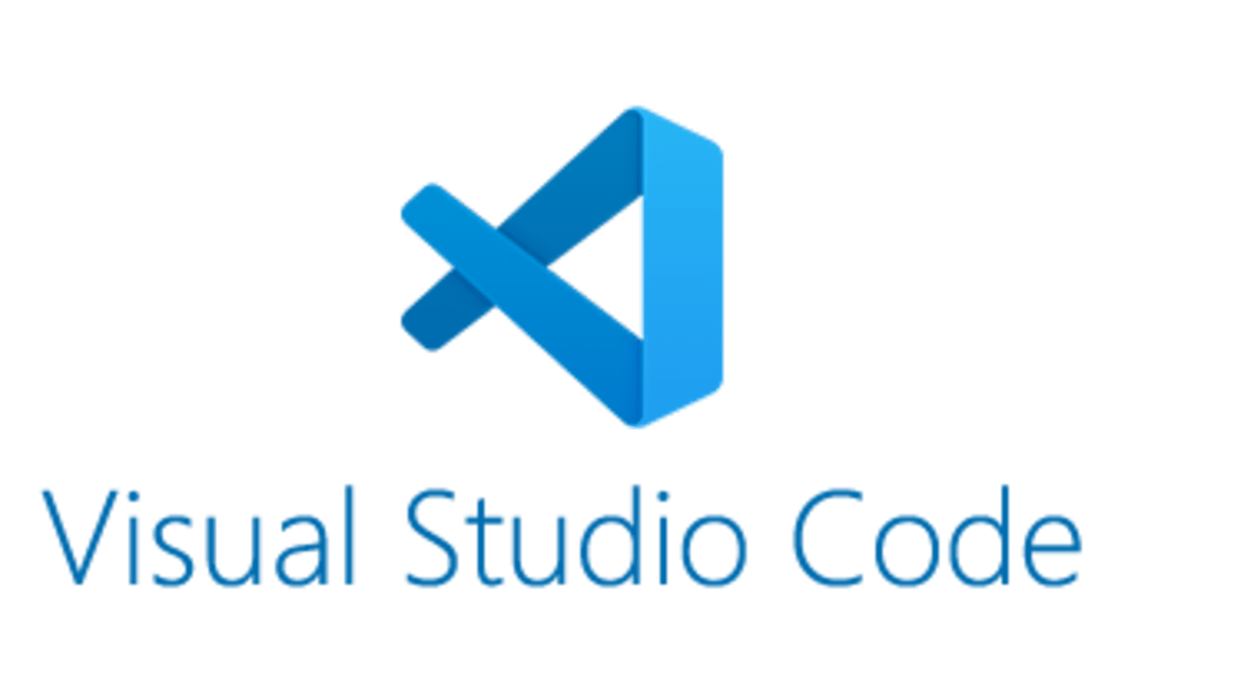





Community engagement
Toolkit and plug-ins to improve Eclipse dev experience
3.6M+ Java repositories hosted, free support and resources for Java devs
Fixes, performance enhancements, and new ports
Java extensions for Maven, Run/ Debug, Unit Testing, and more
Platinum sponsor and project contributor
Support for popular Java standards and projects
Spring Cloud for Azure project and managed service for Spring Boot

Slide 31
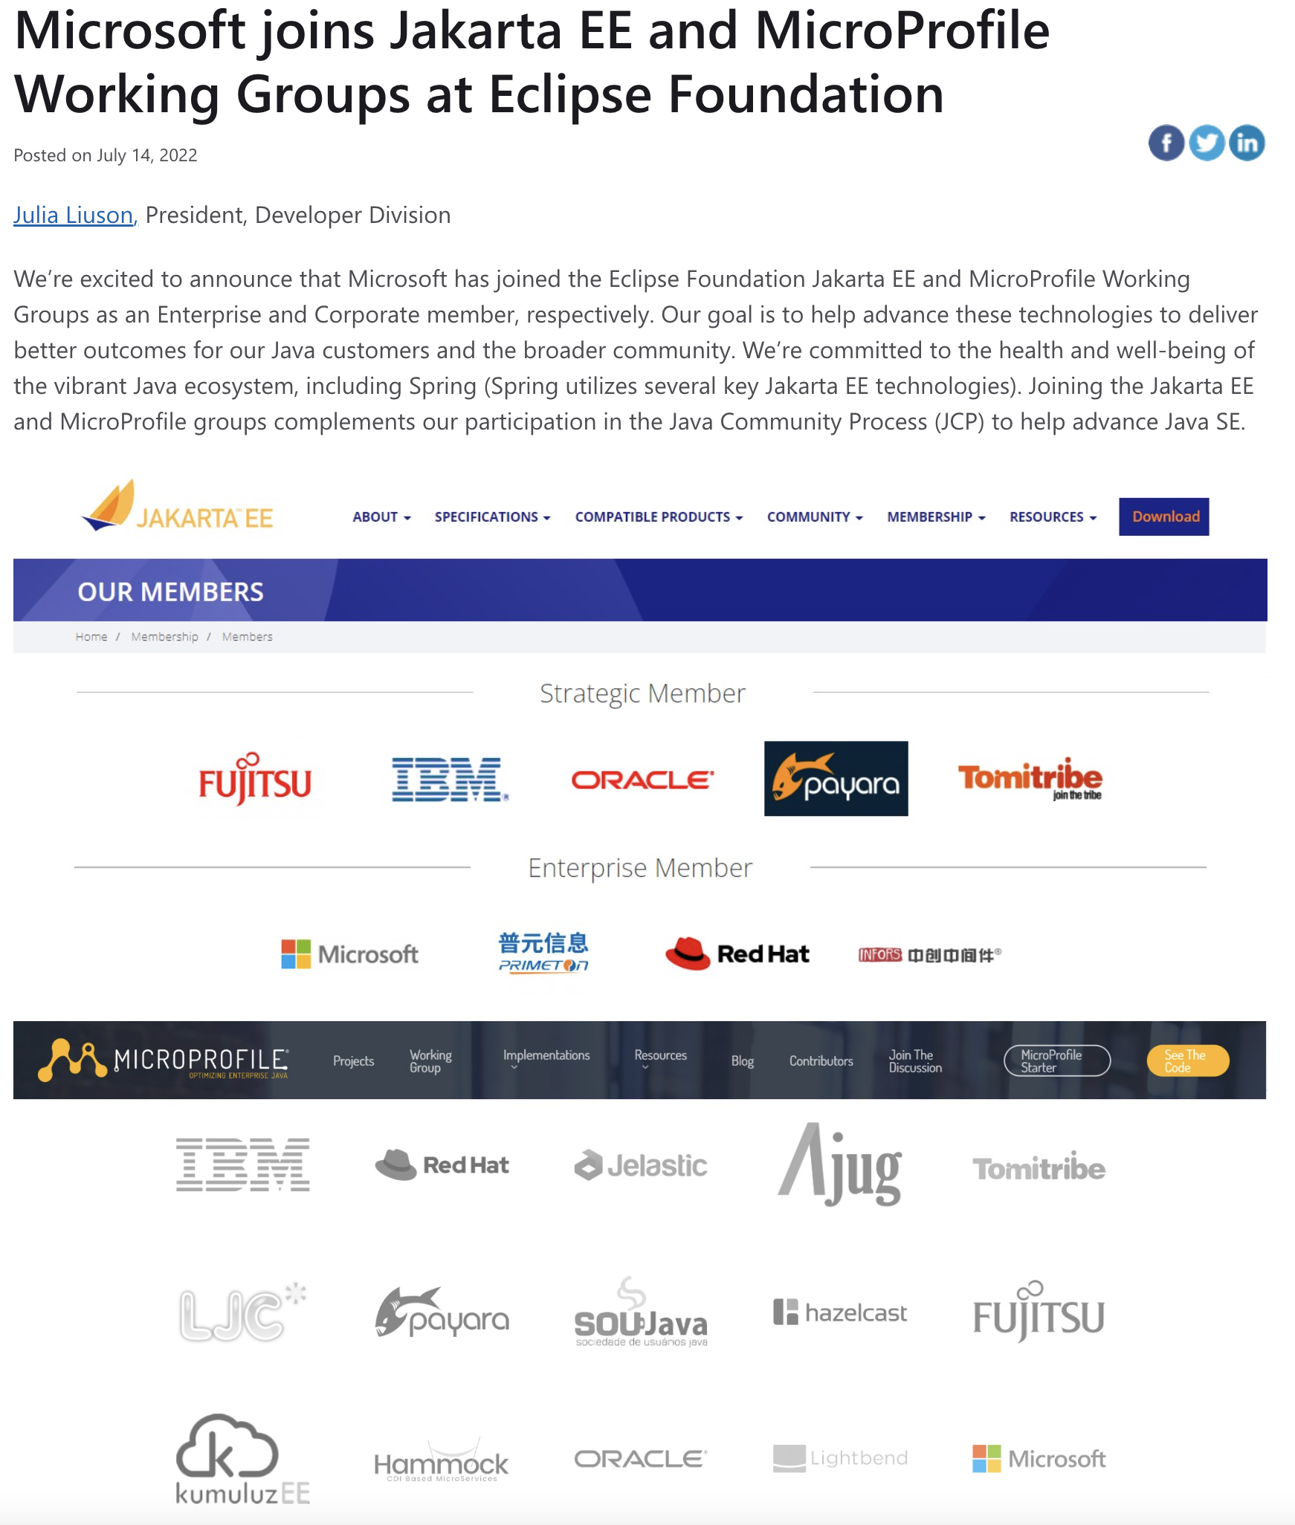
Microsoft Joins Jakarta EE and Microprofile Working Groups at Eclipse Foundation

Slide 32







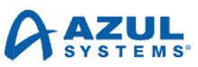







Strong partner ecosystem
Jointly built and operated service—Azure Spring Cloud
Redis Enterprise on Azure managed infrastructure
Jointly supported JBoss EAP on App Service* and VMs
Elastic Cloud on Azure Marketplace
Solution templates for WebLogic on Azure IaaS
Confluent Cloud with Azure Portal and CLI integration
IBM Cloud Pak for Data in Azure Marketplace
OpenJDK support for all LTS Java versions
*JBoss EAP on App Service is in public preview

Slide 33

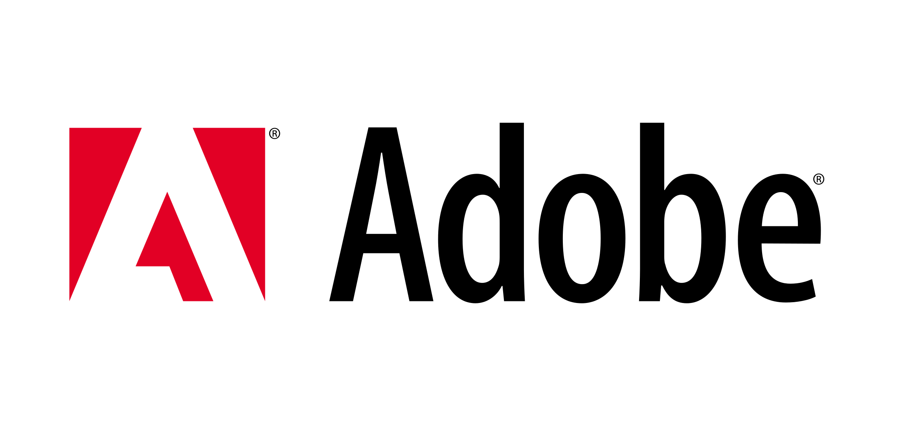








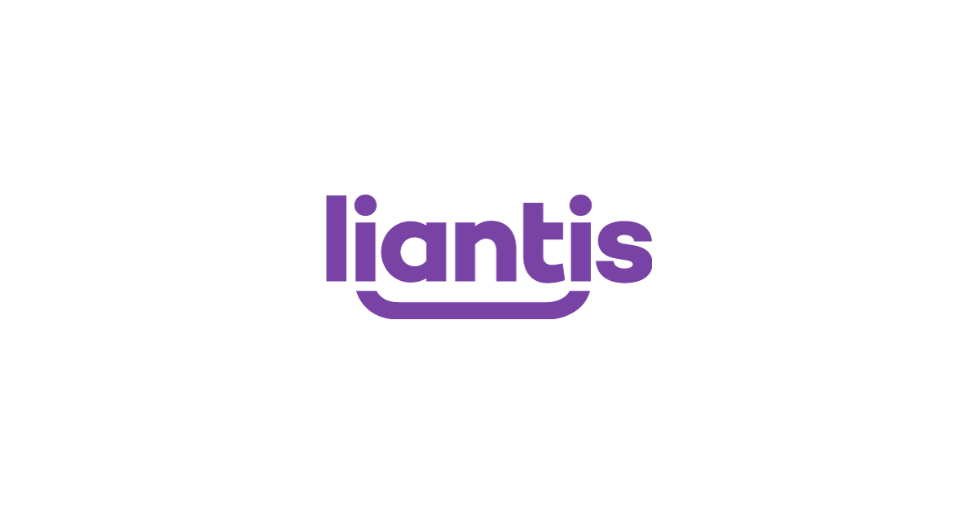














Enterprises run their Java applications on Azure

Slide 34




Java is widely used across Microsoft
2M+ JVMs in production*
LinkedIn
Over 1800+ Java microservices in production Over 60+ Java open-source projects on GitHub
Mojang’s Minecraft
Hundreds of servers built in Java
Client Java Edition is very popular
Azure
Services dependent on Java include, Azure HDInsight, Azure Databricks, and Azure Spring Cloud, and internal control systems
Android
50+ apps published by Microsoft in Google Play Store
New Surface Duo phone based on Android OS
Yammer
Most of back-end implemented in Java
Bing
>100K JVMs
Leverages Kafka and Hadoop
*Internal usage; does not include customer workloads

Slide 35
Review Goals
How to shift left & accelerate microservices development
GitHub Codespaces, Remote Containers, Azure Dev-Box, Dapr, App Insights auto-instrumentation
Understand Azure platform options for Java
EAP & Tomcat on App Service; Spring Boot on Spring Apps; Containers on AKS, ACA and ARO
Dispel myth about Microsoft and Java
Community Involvement (MS Open JDK, Eclipse Foundation Strategic Member), Partners (VMWare, Red Hat, IBM, Oracle, Confluent and more), Enterprises w/Java on Azure (Adobe, Bosch, Daimler, FedEx, J.B. Hunt, Kroger, Maersk, Mercedes, Swiss Re), Java within Microsoft (Bing, LinkedIn, Yammer, Minecraft, Azure)
See it in action
Demo

Slide 36

List of Resources
Java Resources
https://aka.ms/AAi7j3p
Codespaces
https://github.com/features/codespaces
VS Code Remote Containers
https://code.visualstudio.com/docs/remote/containers
Azure Dev-Box
https://azure.microsoft.com/en-us/services/dev-box/#overview
DAPR
https://docs.dapr.io/
JDD Repo
https://github.com/kevingbb/jdd2022

Slide 37
Thank You!

